Slide 1
Web Applications
Unit 2

Slide 2
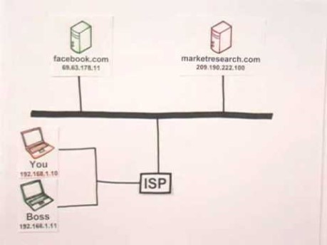
How Does the Internet Work?
https://youtu.be/7_LPdttKXPc

Slide 3
What Is a Server?
A computer connected directly to the internet
Running special software that
Listens for requests
Sends a response
The word server can refer either to the hardware or the software

Slide 4




Types of Servers
Email server
File server
Web server
Application server
Minecraft server
Provides a service

Slide 5
What Is a Client?
The consumer of the service
Makes the request
Receives the response
Usually a separate computer
Sometimes refers to the human using the computer

Slide 6

Re: The Web
In web page terms, what is usually the client?
Web clients request HTML
Hypertext Markup Language

Slide 7
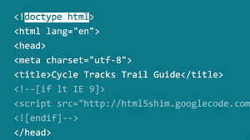
HTML
A text document
Contains special semantic syntax*
Contains the content of the web page
*A separate text document (CSS) provides the style information

Slide 8
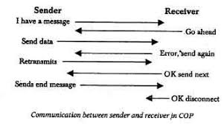
Protocols
For two computers to communicate, they have to agree on how to
format
transmit
and process
information that is sent back and forth

Slide 9
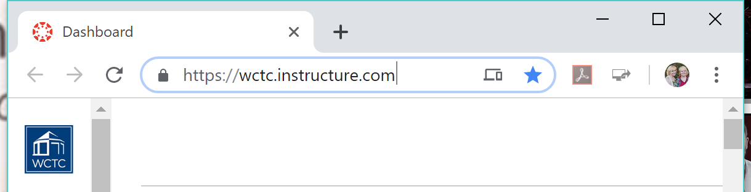
HTTP
Hypertext Transfer Protocol
Communication rules between web server and web client
Our server code will:
receive an HTTP request
send back an HTTP response

Slide 10
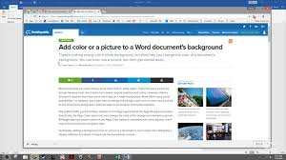
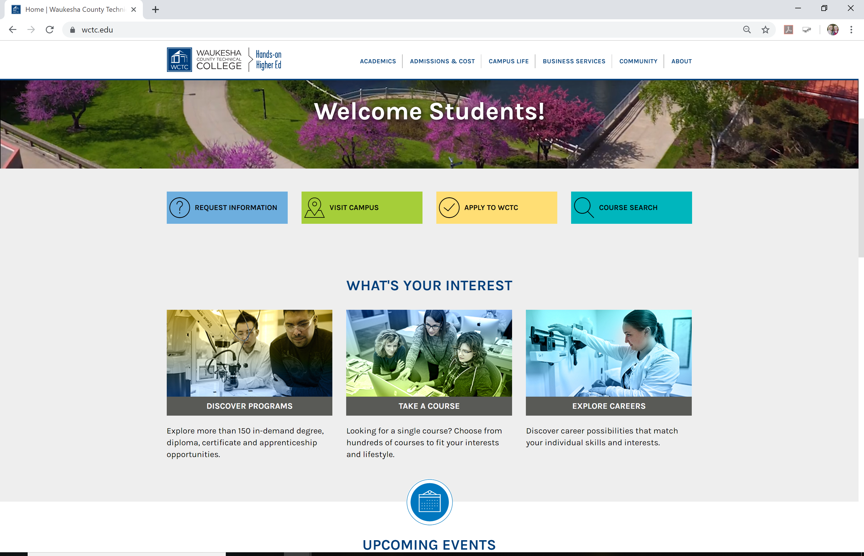


Many Requests, Many Responses
The web page we see in the browser isn't a single file
Not like a Word document or PDF
One file
Images embedded
Fonts and styles embedded
Many files
Each resource is down- loaded independently

Slide 11
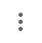
Try It Out
In Chrome, open any web page
F12 or
More tools > Developer tools
Click on the Network tab
Refresh the page

Slide 12
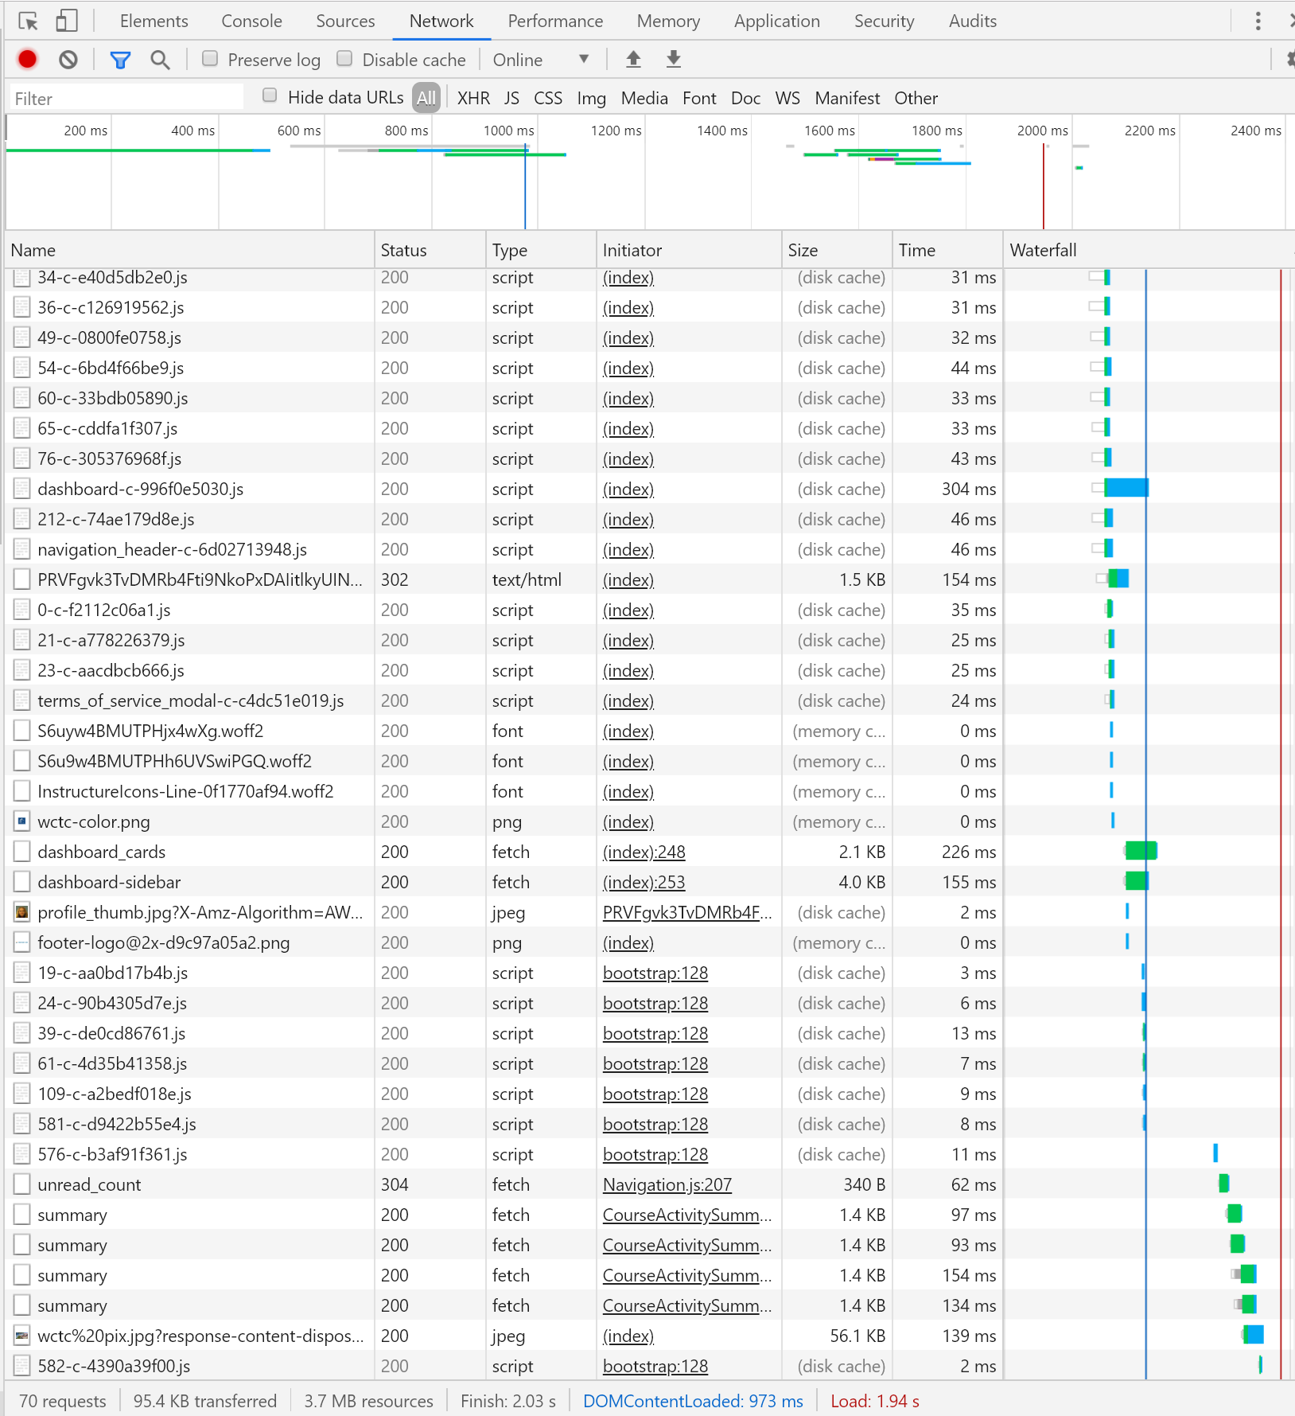
Dozens of Requests
Check the number of requests on the bottom
How much data was transferred?
How long did the entire process take?

Slide 13
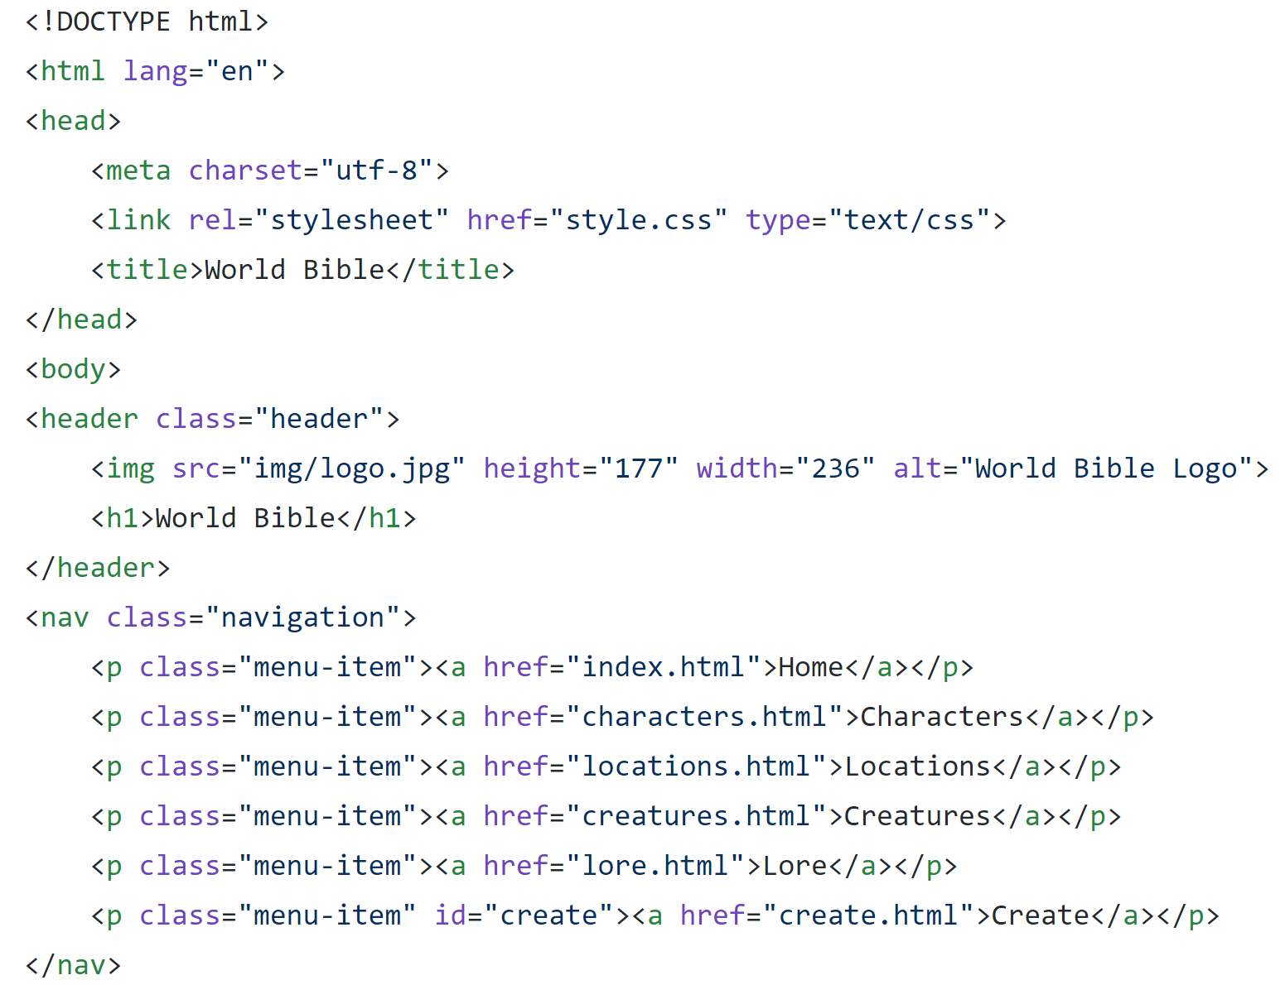
How Did It Know?
We link to resources in the HTML we write
The browser sees href="style.css"
It sends a second request to the server for that file
The browser sees href="img/logo.jpg"
It sends a third request to the server for that file
index.html

Slide 14
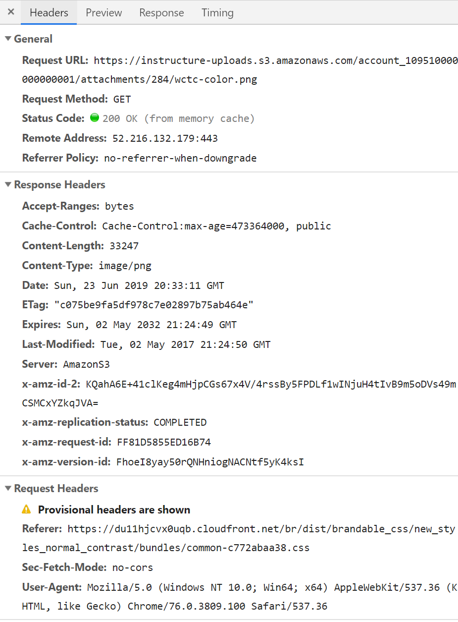
Browser Requests, Server Responds
Click on one of the image requests (PNG or JPG)
Choose the Headers tab
Inspect the request and response information
See the Request Method?

Slide 15
The GET Method
GET is the simplest
A request to get a resource and send it back
Data (perhaps from a form) is appended to the URL
Insecure
Size limitations
https://javapuppy.com/javascript/querystring/submitme.html

Slide 16
The POST Method
The client wants the server to create or update something
Information becomes part of the message body
Secure (-able)
No size limitations

Slide 17
Less Common Methods
HEAD, TRACE, PUT, DELETE, OPTIONS, CONNECT
https://www.w3schools.com/tags/ref_httpmethods.asp
https://pollev.com/stacyread177

Slide 18
Ports
What if one physical computer was running both mail server software and web server software?
How would the computer direct requests to the right software?
The request includes a port number
Most web servers use port 80 (HTTP) and 443 (HTTPS)

Slide 19
URLs
Uniform resource locator
The complete address of any resource on the internet
http://www.javapuppy.com:80/javascript/index.html
server address
path
protocol
port
resource

Slide 20
URLs
You can omit the port if it's the default
Tomcat uses port 8080 for HTTP so it must be included
http://localhost:8080/worldbible/index.html

Slide 21

What Is Tomcat?
It's a web server
It can process requests for static files
HTML, CSS, and JavaScript files
Images and videos
It's open source
Maintained by Apache
https://tomcat.apache.org/

Slide 22
What Is Tomcat?
It's a servlet container
A servlet is a Java class that encodes HTML documents
Servlets inherit from the HttpServlet class
public void MyServlet extends HttpServlet {...}

Slide 23
HttpServlet Class
public void MyServlet extends HttpServlet {
public void doGet(HttpServletRequest request, HttpServletResponse response) throws IOException {...}
}
A specialized class that
takes GET and POST requests
does some processing
returns HTML

Slide 24
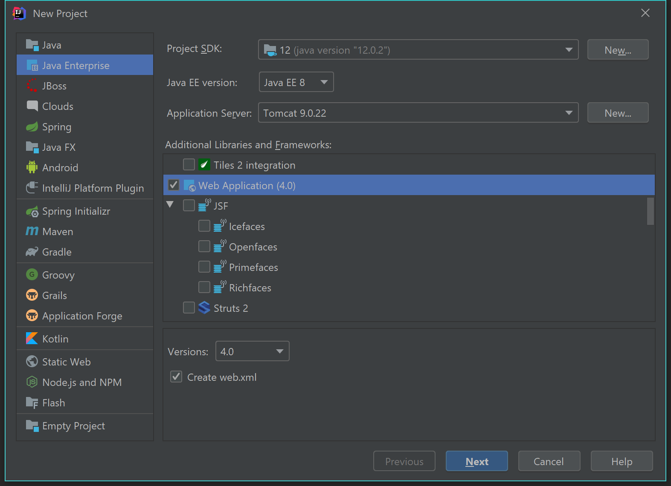
Try It Out
In IntelliJ, select File > New > Project
In the left list, select Java Enterprise
Check that Application Server is Tomcat 9.0.X
In the Additional Libraries list, check Web Application

Slide 25
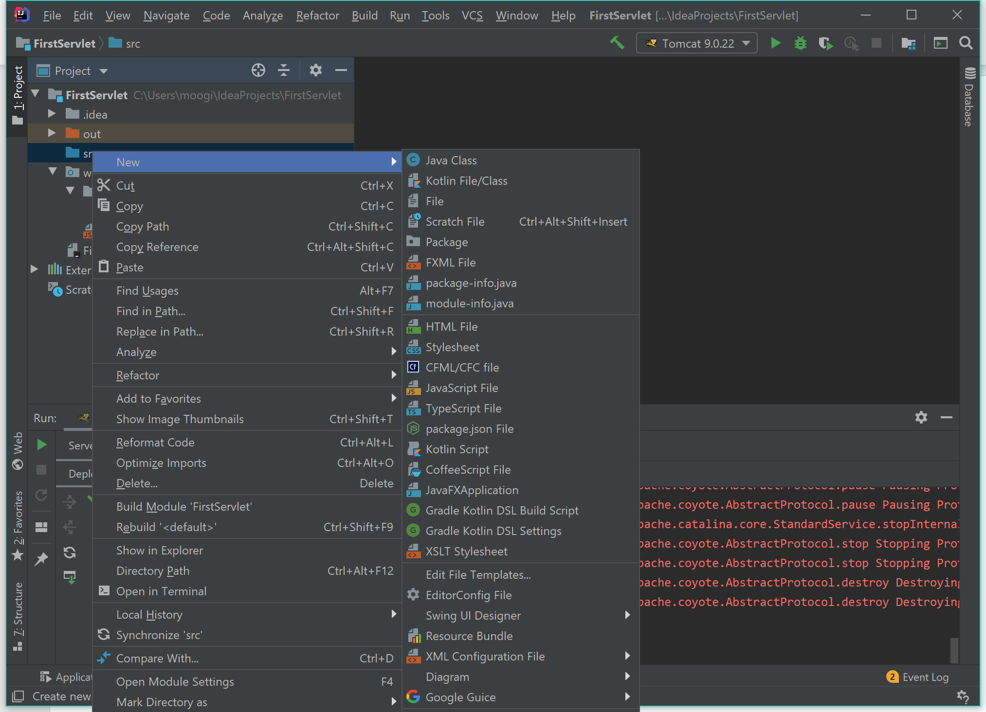
Try It Out
Give the project a name
Expand the project folder and locate the src folder
Right click the src folder and select New > Create New Servlet
(It's close to the bottom)

Slide 26
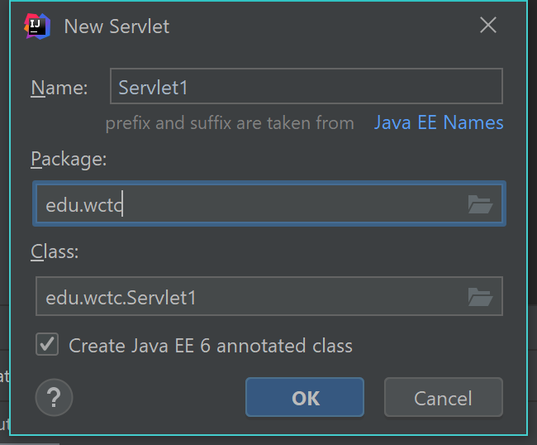
Try It Out
Give the servlet a name
(This will be the name of the class)
You can also choose a package
Leave the checkbox checked

Slide 27
Try It Out
Inside the doGet method, let's send a response
response.getWriter() returns an output stream that works just like System.out
String message = "<html><body>Hello world</body></html>";
response.getWriter().print(message);

Slide 28
Try It Out
We specify servlet metadata in the annotation
IntelliJ should have prefilled the servlet name:
@WebServlet(name = "Servlet1")
We need to add the URL mapping:
@WebServlet(name = "Servlet1", urlPatterns = "/hello")

Slide 29
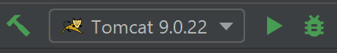
Try It Out
In the top right menu bar, click the green arrow to start Tomcat
A browser should open with the default page
In the address bar, append the urlPattern you used in the annotation
start

Slide 30
Things to Note
There is no main method!
Tomcat is written in Java
It controls our HttpServlet classes

Slide 31
What Tomcat Does
Listens for HTTP requests on port 8080
Finds the appropriate servlet
Passes request and response objects to that servlet
The servlet generates HTML code as a String
The servlet prints the HTML to the response object's output stream

Slide 32
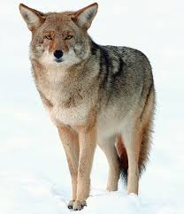
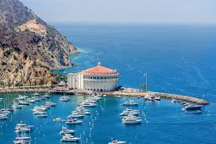
Tomcat Components
Tomcat is a collection of components that work together
Tomcat contains a web server
Named Coyote
Tomcat contains a servlet container
Named Catalina
Do you remember seeing these names anywhere?

Slide 33
Changing the Name
FirstServlet_war_exploded is a terrible name
Let's change it
In IntelliJ's top menu, select Run > Edit Configurations

Slide 34
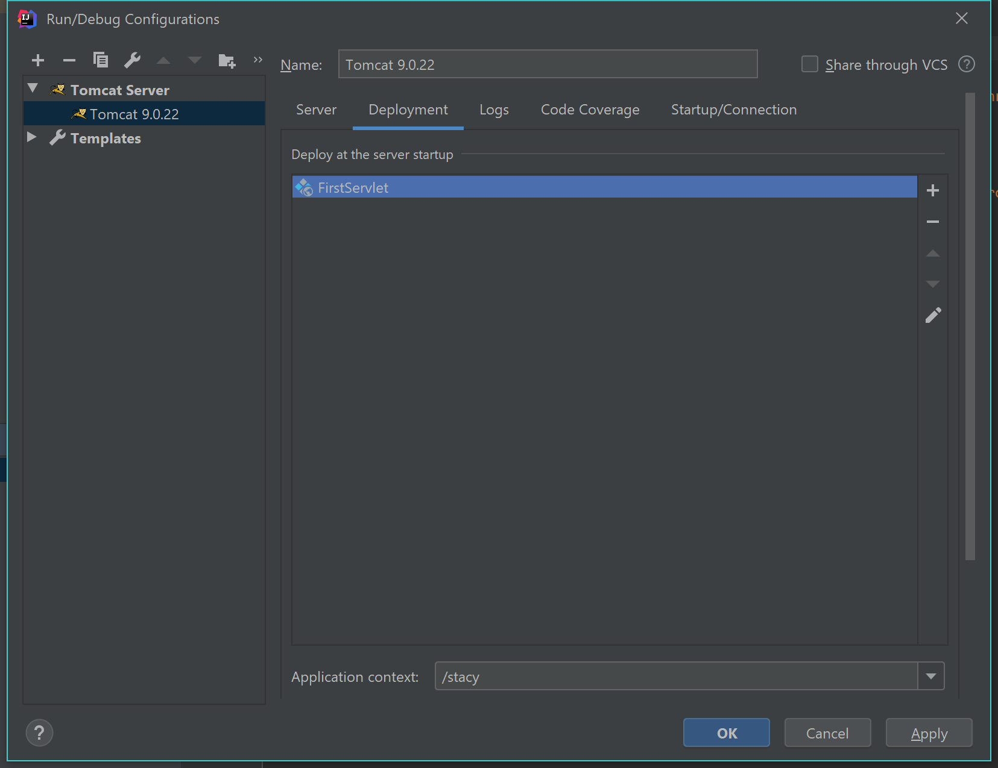
Changing the Name
With Tomcat 9.0.X selected, select the Deployment tab
Update the Application context to something better
stop

Slide 35
Interacting with the Client
Let's make a simple web page with a form
The browser will request the page
Tomcat's web server will supply it

Slide 36
Interacting with the Client
When the user clicks the form's Submit button, the browser will make a second server request
It will send the form's contents to the servlet's address
The servlet will build a String of HTML and send it back

Slide 37
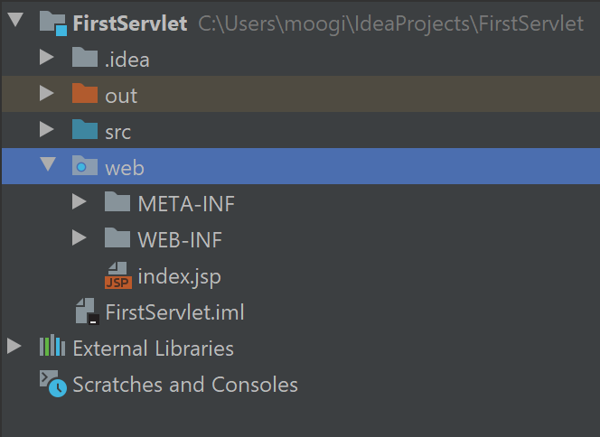
Serving Static Files
Tomcat is a web server
It can serve HTML files, images, etc.
Everything in the web directory will be accessible in the browser by its resource name

Slide 38
Create an HTML Form
Right click on the web directory
Select New > HTML File
Name it form.html
Replace the text between the <title> tags with Demo Form

Slide 39
HTML Forms
A form is created with a pair of <form> tags
Two attributes should be specified
method: GET or POST
action: The URL to which the form should send its values
<form method="get" action="hello">
<!– input boxes, etc. go here -->
</form>

Slide 40
Form Attributes
If no method is specified, GET is the default
The action is usually relative to where the HTML file originally came from
Example: The URL of form.html is http://localhost/FirstServlet/form.html
An action of "hello" will submit the form to http://localhost/FirstServlet/hello

Slide 41
Form Controls
To send information to the server, add form controls between the <form> tags
Let's add a simple text box
<form method="get" action="hello">
<input type="text" name="param1">
</form>
See a list of input types here

Slide 42
The name Attribute
It's very important to give each form control a name attribute
<input type="text" name="param1">
Form information is sent as name=value pairs
On the server, we'll use the name to retrieve the value
Revisit this example and look at the page source

Slide 43
Submit Button
To make the form performs its action, a special button should be included between the <form> tags
<form method="get" action="hello">
<input type="text" name="param1"><br/>
<input type="submit" value="Submit with GET">
</form>
newline

Slide 44
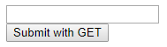
Submit Button
Doesn't need a name attribute
The value is displayed on the button widget
<input type="submit" value="Submit with GET">

Slide 45
Test It Out
Start Tomcat
In the browser, navigate to form.html
Type some text in the box
Submit the form

Slide 46
Retrieving Form Information
Let's modify the servlet to retrieve the form values
Where do you think they'll be?
protected void doGet (HttpServletRequest request, HttpServletResponse response) throws ServletException, IOException {
// code here
}

Slide 47
Ask the HttpServletRequest
The request object contains all parameters
Ask for "param1" by name
protected void doGet (HttpServletRequest request, HttpServletResponse response) throws ServletException, IOException {
String p1 = request.getParameter("param1");
}

Slide 48
Modify the Response HTML
Change the message string to include the user's parameter
String p1 = request.getParameter("param1");
String message = "<html><body>You said: " + p1 + "</body></html>";
response.getWriter().print(message);

Slide 49
Try It Out
Modify form.html
Create a second form that uses POST
Note: Don't place one form inside the other
Modify FirstServlet.java
Implement the doPost method

Slide 50
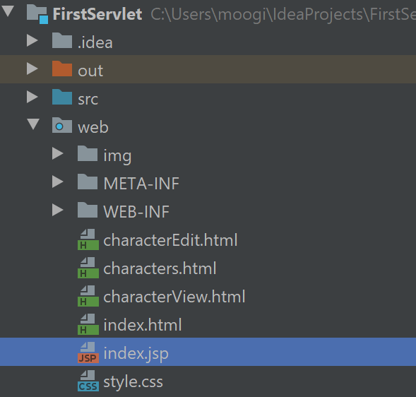
Copy Files
Copy all the files from your Unit 1 site into the web directory
You might want to download and extract a .zip file from GitHub
You can delete index.jsp now, if it's present
Stop and restart Tomcat

